Slide 1

Reinforced trading using ai
REVIEW - I

Slide 2
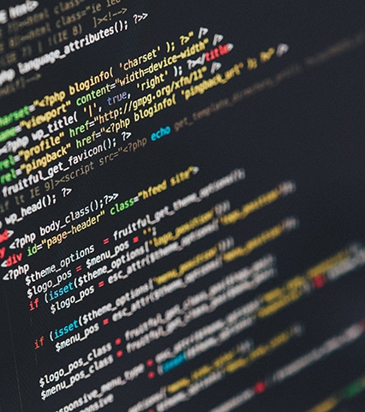
INTRODUCTION
A brief insight

Slide 3

Trading
Backbone of economy?
Trade involves the transfer of goods or services from one person or entity to another, often in exchange for money. Economists refer to a system or network that allows trade as a market.
A stock market is the aggregation of buyers and sellers (a loose network of economic transactions, not a physical facility or discrete entity) of stocks (also called shares), which represent ownership claims on businesses; these may include securities listed on a public stock exchange, as well as stock that is only traded privately, such as shares of private companies which are sold to investors through equity crowdfunding platforms. Investment in the stock market is most often done via stockbrokerages and electronic trading platforms. Investment is usually made with an investment strategy in mind.

Slide 4

Abstract
Quick Overview
This project is made for the J-Component of Artificial Intelligence course, the main objective of doing this project is to implement a program for real-life problems with AI and understand its working.
The aim of our project is to train an AI over a standard stock market dataset and allow him to trade in order to get most profit over time. The financial market in real is very uncertain and possess high risk factors, therefore the implementation of this project can’t be used in real-life trading. The main purpose is to get familiar and learn, with the implementation of this project, about the flow work of Artificial Intelligence and usage of different approaches along with the various libraries to obtain desired applications.
We’ll be focusing on the S&P 500 index dataset to train our agent with reinforcement learning through Keras API (which uses TensorFlow in its backend) to predict the Stock Market prices over time and take appropriate trade decisions in order to obtain maximized profit.
More details about the project will be further discussed in the presentation.

Slide 5
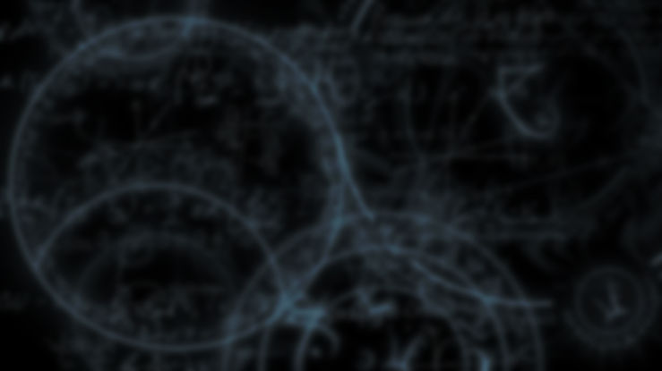
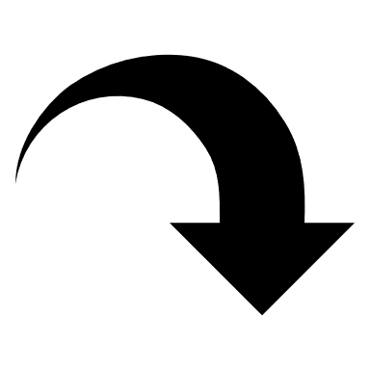
Problem Description
Artificial Intelligence is taking over in pretty much every segment, and the financial market is no special case.
Making mechanized algorithmic exchanging models will accommodate a quicker and progressively precise examination of stocks before purchase.
Various indicators can be analyzed at a speed that people are unequipped for. Additionally, in case of humans, it is risky to work with feelings.
AI models can tackle that issue. There is likewise a decrease in exchange costs, as there is no requirement for persistent supervision.
In order to obtain such a situation, the agent should be aware of various stocks and be able to somewhat predict their future prices.
Reinforcement Learning will be used to train the AI agent to tackle these problems and get optimal results over time.

Slide 6

Reinforcement Learning
The optimal approach?
Reinforcement learning (RL) is an area of machine learning concerned with how software agents ought to take actions in an environment in order to maximize some notion of cumulative reward. Reinforcement learning is one of three basic machine learning paradigms, alongside supervised learning and unsupervised learning.
Reinforcement learning differs from supervised learning in not needing labelled input/output pairs be presented. Instead the focus is on finding a balance between exploration (of uncharted territory) and exploitation (of current knowledge).

Slide 7

Deep q-network
Q-learning learns the action-value function Q(s, a): how good to take an action at a particular state. Q is called the action-value function.
In Q-learning, we build a memory table Q[s, a] to store Q-values for all possible combinations of s and a. If you are a chess player, it is the cheat sheet for the best move.
DQN overcomes unstable learning by mainly 4 techniques.
Experience Replay: Experience Replay stores experiences including state transitions, rewards and actions, which are necessary data to perform Q learning, and makes mini-batches to update neural networks.
Target Network: Unstable target function makes training difficult. So Target Network technique fixes parameters of target function and replaces them with the latest network every thousands steps.
Clipping Rewards: Clipping Rewards technique clips scores, which all positive rewards are set +1 and all negative rewards are set -1.
Skipping Frames: AI doesn’t need to calculate Q values every frame. So Skipping Frames technique is that DQN calculates Q values every 4 frames and use past 4 frames as inputs. This reduces computational cost and gathers more experiences.

Slide 8

Existing methods
How it’s been done in the past?

Slide 9

Paper-1: Rakićević, A., Simeunović, V., Petrović, B., & Milić, S. (2018). An automated system for stock market trading based on logical clustering. Tehnički vjesnik, 25(4), 970-978.
Paper-2: Shin, H. G., Ra, I., & Choi, Y. H. (2019, October). A Deep Multimodal Reinforcement Learning System Combined with CNN and LSTM for Stock Trading. In 2019 International Conference on Information and Communication Technology Convergence (ICTC) (pp. 7-11). IEEE.
Paper-3: Lee, J. W. (2001, June). Stock price prediction using reinforcement learning. In ISIE 2001. 2001 IEEE International Symposium on Industrial Electronics Proceedings (Cat. No. 01TH8570) (Vol. 1, pp. 690-695). IEEE.
Paper-4: Gold, C. (2003, March). FX trading via recurrent reinforcement learning. In 2003 IEEE International Conference on Computational Intelligence for Financial Engineering, 2003. Proceedings. (pp. 363-370). IEEE.
Paper-5: Li, Y., Zheng, W., & Zheng, Z. (2019). Deep Robust Reinforcement Learning for Practical Algorithmic Trading. IEEE Access, 7, 108014-108022.

Slide 10
Authors and Year (Reference) | Title (Study) | Concept / Theoretical model/ Framework | Methodology used/ Implementation | Dataset details/ Analysis | Relevant Finding | Limitations/ Future Research/ Gaps identified
Aleksandar Rakićević Vlado Simeunović Bratislav Petrović Sanja Milić: 2018 | An Automated System for Stock Market Trading Based on Logical Clustering | Interpolative Boolean Algebra | Clustering | Belgrade Stock Exchange data | Interpolative Boolean algebra, used as a basic logical framework, enables to model complex logical relations and expressions in a consistent manner. | Incorporating transaction costs and then testing the proposed method in Daily trading with short selling allowed.
Shin, Hong-Gi Ra, Ilkyeun Choi, Yong-Hoon: 2019 | A Deep Multimodal Reinforcement Learning System Combined with CNN and LSTM for Stock Trading | CNN-FG structure | CNN, LSTM | Korea KOSPI | Using few indicators like MA, DMI, and SSO showed positive Sharpe ratios for all the test experiments. | More indicators can be further used to enhance performance.
Jae Won Lee: 2002 | Stock price prediction using reinforcement learning | Temporal Difference (TD) algorithm | MDP | Korean Stock Market | The experimental result shows that the proposed method might be utilized as a more useful indicator for stock trading. | Reward definition can be improved by applying TD(λ) RL algorithm.
C. Gold: 2003 | FX trading via recurrent reinforcement learning | Simple price model | RRL | Worldwide currencies | Performance is substantially decreased and the dependence on the fixed parameters is altered when the the traders cannot automatically transact at any price which appears in the quote series | In-depth analysis of properties of different currency markets.
Li, Y. Zheng, W. Zheng, Z.: 2019 | Deep Robust Reinforcement Learning for Practical Algorithmic Trading | Deep Reinforcement Learning | LSTM, SDAEs | Thomson Reuters History (TRTH) | The proposed framework increases robustness by adopting SDAEs and provide better practical applications. | The proposed method can be extended to handle multiple assets simultaneously.

Slide 11
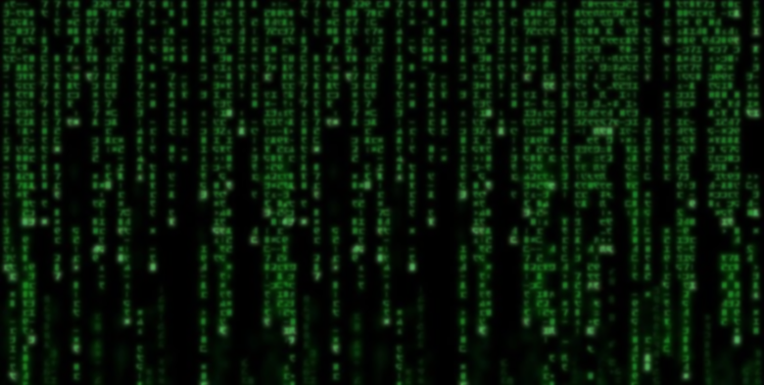
Proposed work
How we’re going to do it!

Slide 12
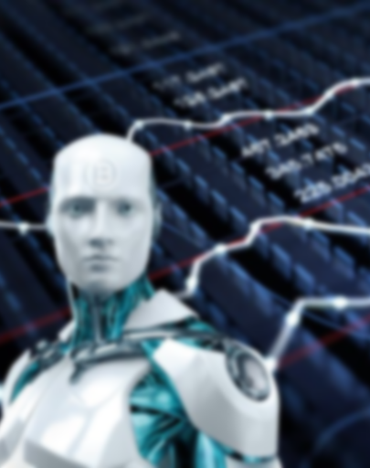
# The proposed approach
The proposed work will be using an actor-critic model for the implementation of our AI Trading agent. The agent will have 3 possible actions: Hold, Sell, and Buy.
In hold action, the agent will do nothing and hold a stock, whereas in Buy and Sell action the agent will Buy more stocks and Sell the stocks respectively.
The motive will be to gain as much profit as possible and the same will be used as Reward for RL.
To form the neural network for our model, we’ll be using Keras package for the same as it is quite user friendly and provide better functionality.

Slide 13
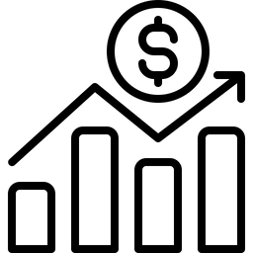
The actor-critic model will use two interactive network models in which the actor will analyse the environment and take the decision to make an action.
Then the set of observations and the action performed on the actor-network will be forwarded to the critic-network, which will evaluate the decisions of the actor and provide with feedback.
The critic computes an approximation, which is used to update actor in the direction of its gradient over time to make better decisions. This is more advanced approach to the tradition DQN method.
Over time, the Q-value prediction of critic will improve, further allowing the actor to make better decisions.
To support the requirements, we will incorporate the time series forecasting method with our model.

Slide 14
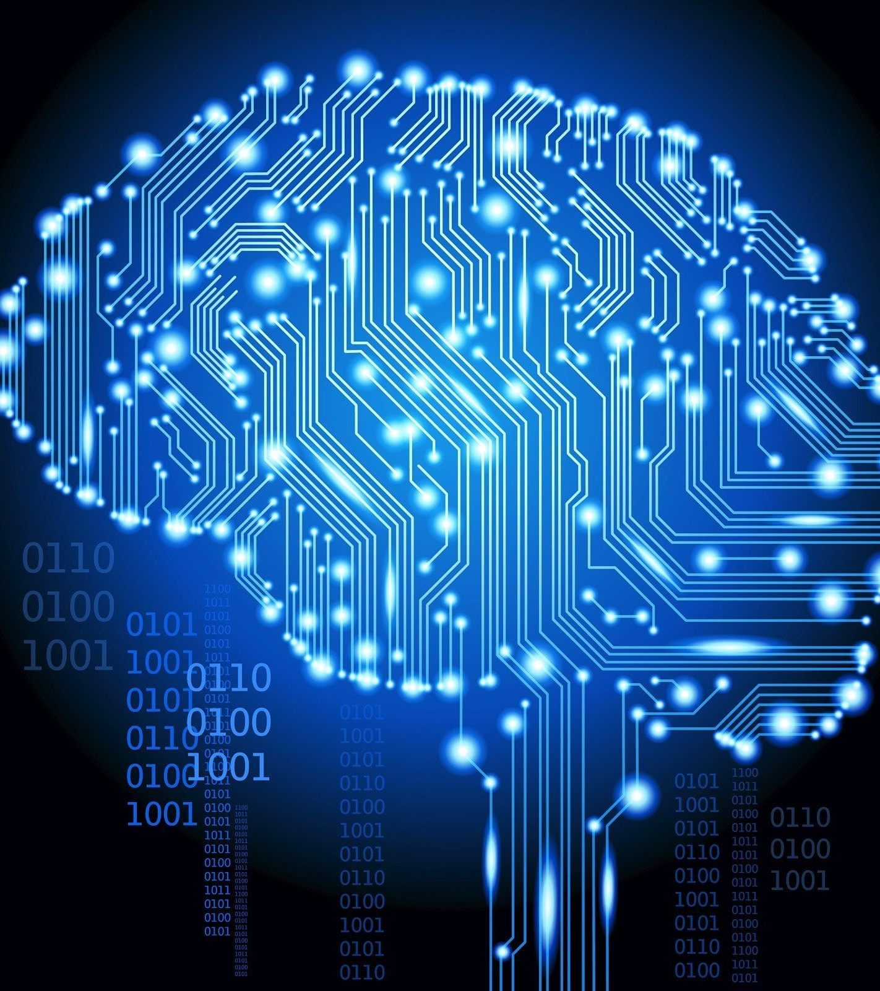
tools used
PYTHON
TENSORFLOW
Keras
Dataset used
S&P 500 Index

Slide 15

https://en.wikipedia.org/wiki/Trade
https://en.wikipedia.org/wiki/Stock_market
https://en.wikipedia.org/wiki/Reinforcement_learning
https://en.wikipedia.org/wiki/TensorFlow
https://en.wikipedia.org/wiki/Keras
https://towardsdatascience.com/welcome-to-deep-reinforcement-learning-part-1-dqn-c3cab4d41b6b
https://www.geeksforgeeks.org/deep-q-learning/
https://machinelearningmastery.com/time-series-forecasting/
https://en.wikipedia.org/wiki/Time_series
https://www.infoworld.com/article/3336192/what-is-keras-the-deep-neural-network-api-explained.html
https://towardsdatascience.com/algorithmic-trading-bot-python-ab8f42c37145
REFERENCES

Slide 16
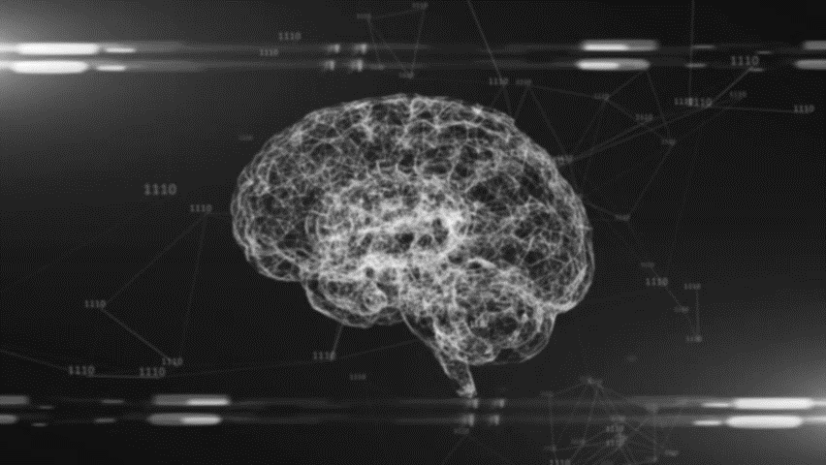
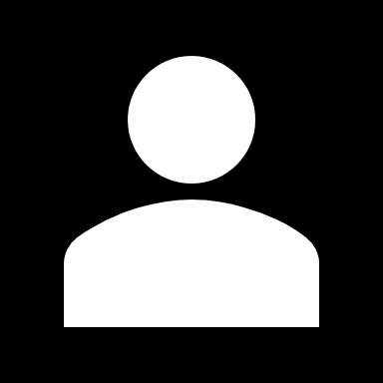
THANK YOU
SHAURYA CHOUDHARY

